Slide 1

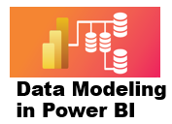



2 Tables Relationships
Prepared By :
Said Fawzy
Manager of Information Center
Tendering Department
Arab Contractors

Slide 2
2 Tables Relationships
Prepared By :
Said Fawzy
Manager of Information Center
Tendering Department
Arab Contractors

Slide 3

1
Fact and Dimension Tables
2
Normalization and Denormalization
3
Cardinality and Granularity
4
Model Relationship

Slide 4
5
Cross-Filtering Direction

Slide 5
1
Fact and Dimension Tables

Slide 6
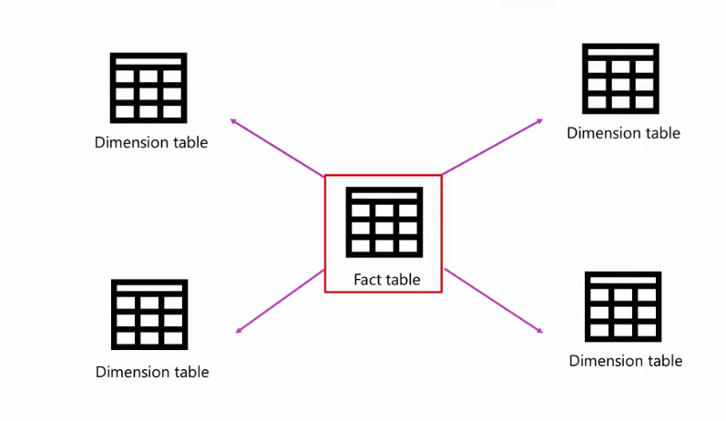
Fact Tables and Dimension Tables
A schema is a logical and visual representation of how your fact and dimension tables relate

Slide 7


Slide 8
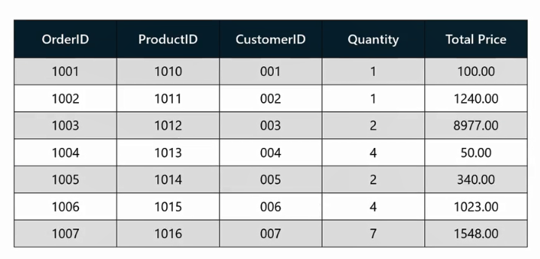
Sales Order Fact Table

Slide 9


Slide 10
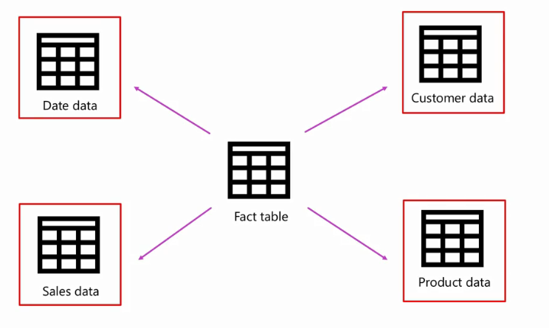

Slide 11
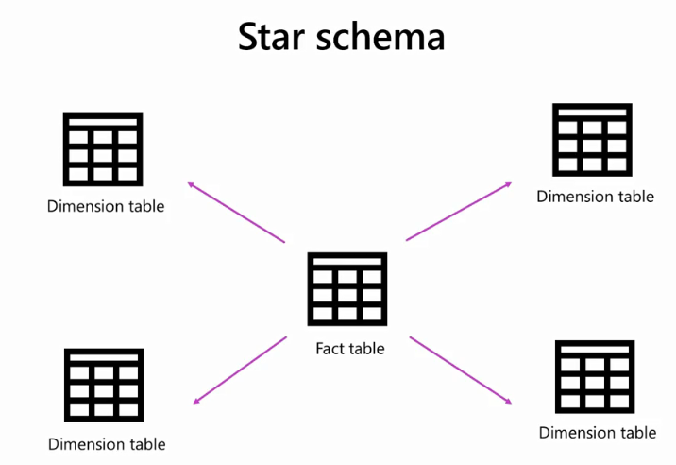

Slide 12
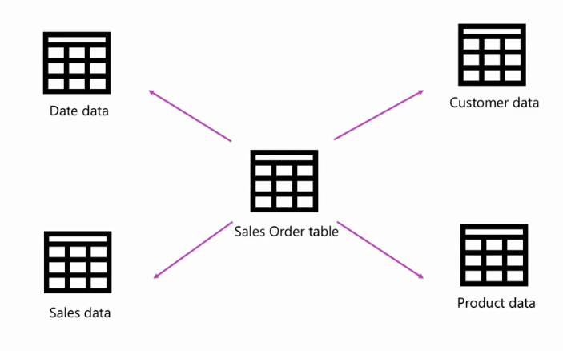

Slide 13
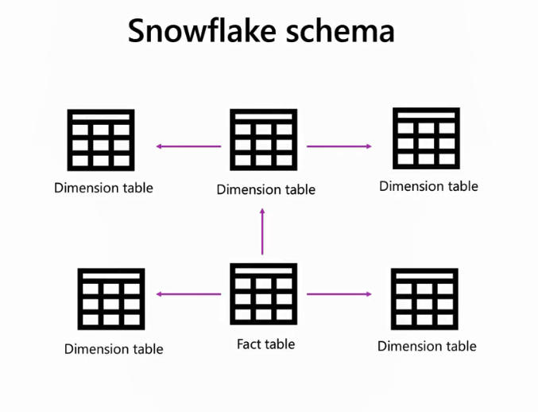
Normalization
Normalization

Slide 14
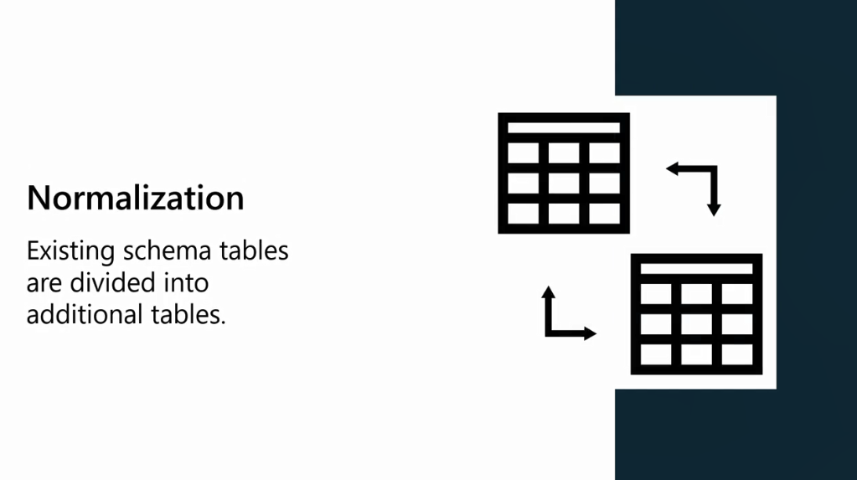

Slide 15
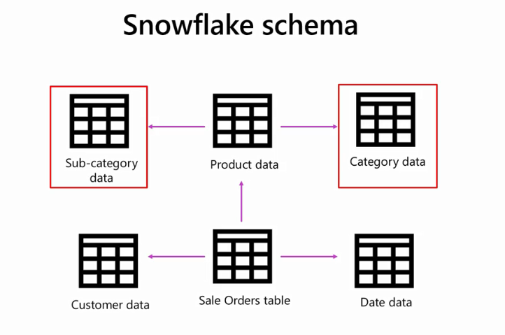

Slide 16
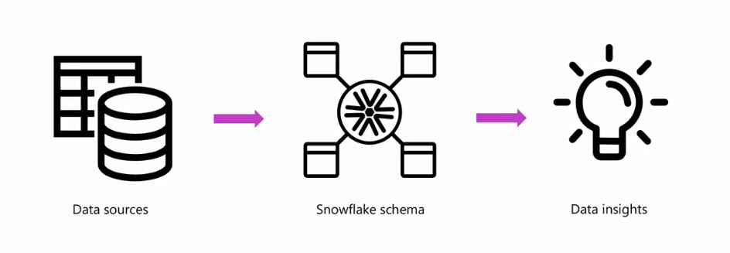

Slide 17

Question
Adventure Works is building a star schema in Power BI. Which of the following tables in the schema can be used to store measurable business data like order and product IDs, quantities, and total cost?
A Customer table that holds data on customers.
A Sales table that contains data on sales transactions.
A Product table that contains information on products.

Slide 18
ANSWER
Adventure Works is building a star schema in Power BI. Which of the following tables in the schema can be used to store measurable business data like order and product IDs, quantities, and total cost?
A Customer table that holds data on customers.
A Sales table that contains data on sales transactions.
A Product table that contains information on products.

Slide 19
2
Normalization and Denormalization

Slide 20
Normalization
Normalization is a data model design technique that involves structuring data to minimize redundancy and ensure data integrity.
It divides data into multiple related tables, each with a specific purpose.
This approach reduces data duplication. However, it often requires creating complex relationships between the

Slide 21
Normalization offers the following advantages:
• Removal of redundant data.
• Improved data integrity.
• Easier maintenance of your data model

Slide 22
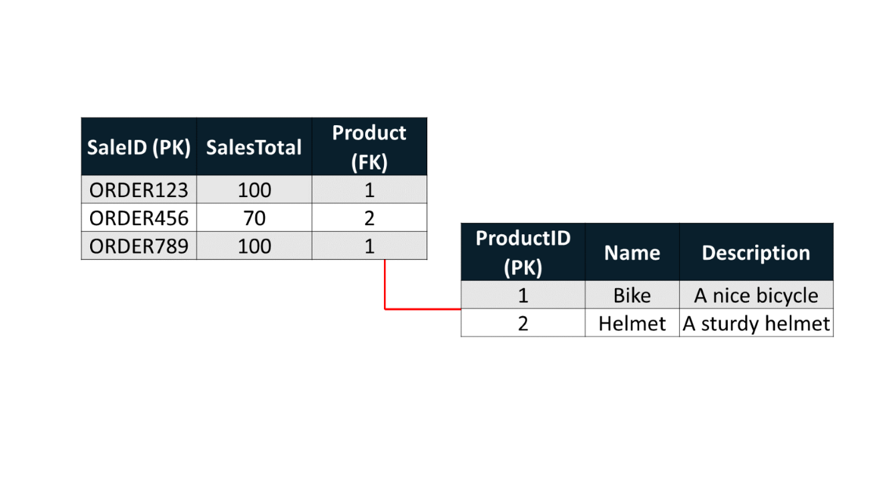
Normalization
With normalization, relationships are established between tables by using primary and foreign keys.
Primary keys are columns that uniquely identify each row of data.

Slide 23
Denormalization
• Denormalization is the reverse process of normalization.
• It involves converting the normalized schema into a schema that has redundant information.
• Implementing denormalization helps to avoid expensive queries between the tables but at the cost of creating redundant or duplicated data.

Slide 24
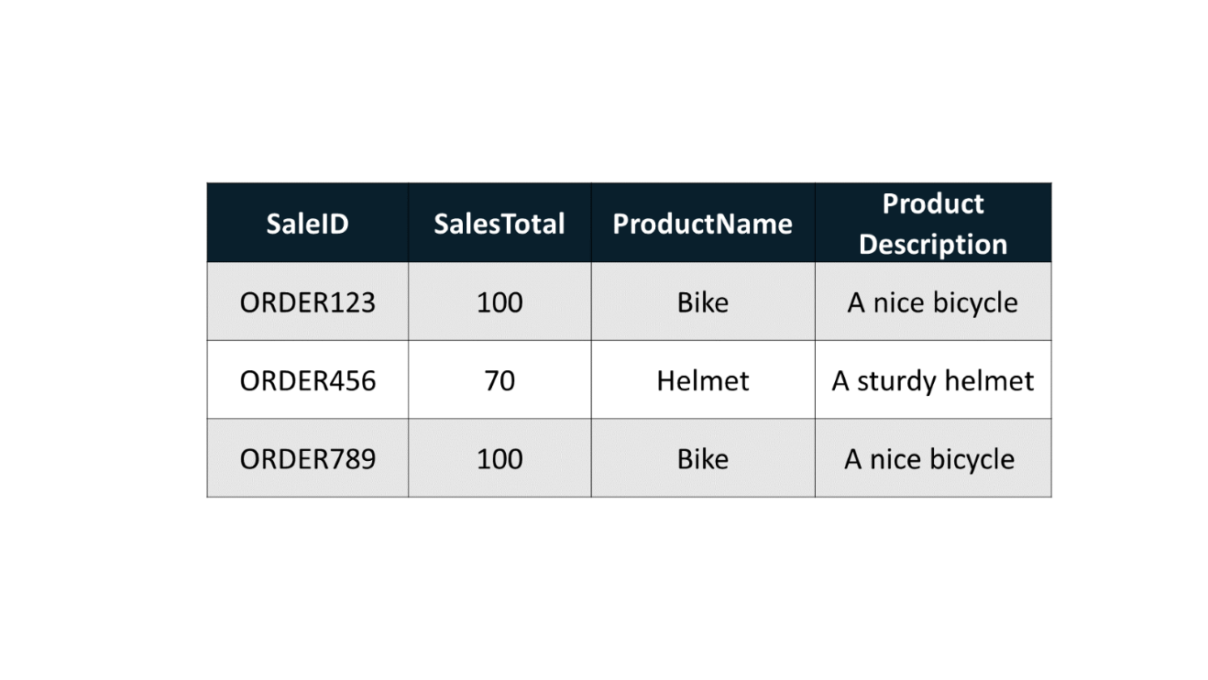
Denormalization

Slide 25
Denormalization offers some benefits
Instead of loading multiple data tables in your data model, you have only one large table, which could be more efficient in performance. With no relationship between tables, queries to join the data are reduced.
Filter propagation between the tables may sometimes be less efficient than filters applied to a single table.
Establishing a hierarchy from fields within a table is simpler.

Slide 26
Difference between normalization and denormalization
Data integrity
Data integrity is maintained during the normalization process.
On the other hand, data integrity is harder to maintain with a denormalized model. This is because multiple rows may need to be updated when data changes.

Slide 27
Difference between normalization and denormalization
Redundant data
Redundant data is eliminated when normalization is performed.
However denormalization increases redundant data.

Slide 28
Difference between normalization and denormalization
Model size
Normalization increases the number of tables and join queries (due to relationships between tables).
In contrast, denormalization reduces the number of tables and relationships.

Slide 29
Difference between normalization and denormalization
Memory
Disk space is overused in a denormalized schema because the same data is stored elsewhere.
On the contrary, disk space is optimized in a normalized schema.

Slide 30
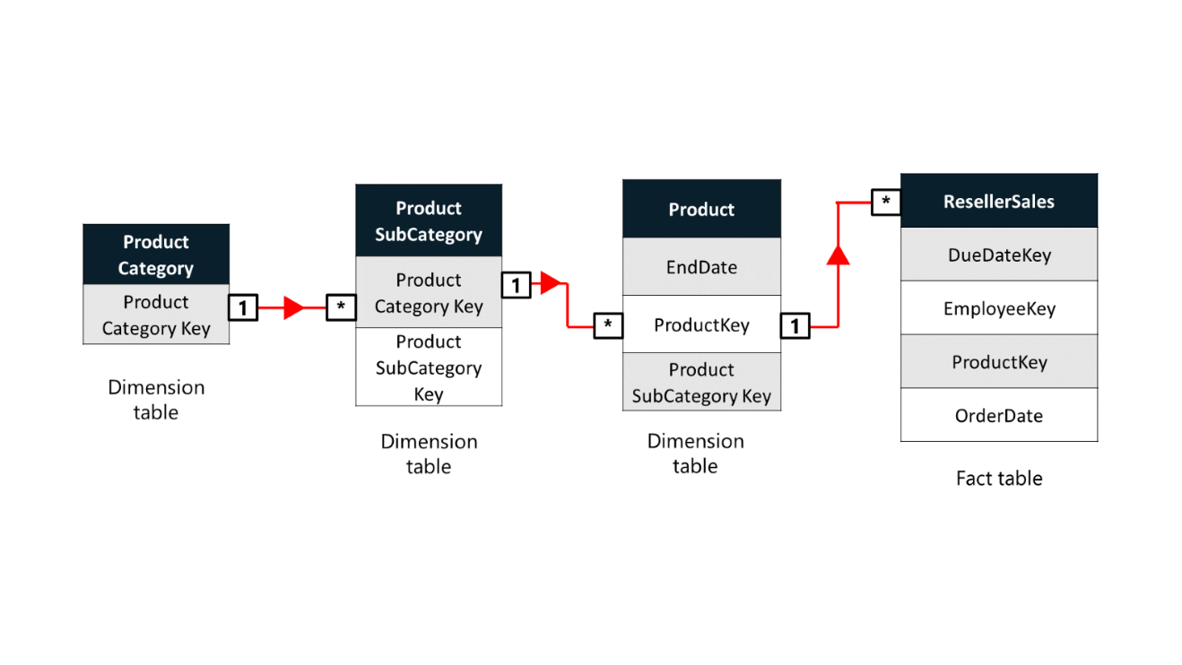
Example
In this model, the Product dimension table is normalized and stored in three separate tables:
Category,
Subcategory,
Product

Slide 31
Example
Denormalize your model
You can use Power Query to transform these tables into a single product table using the Merge queries feature.

Slide 32
3
Cardinality and Granularity

Slide 33


Slide 34
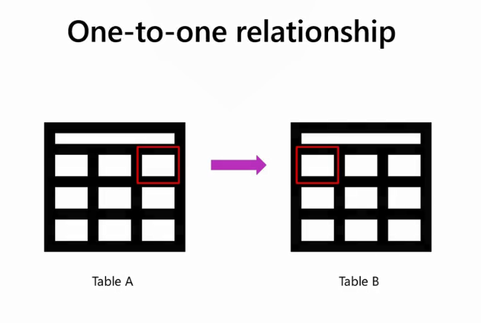

Slide 35
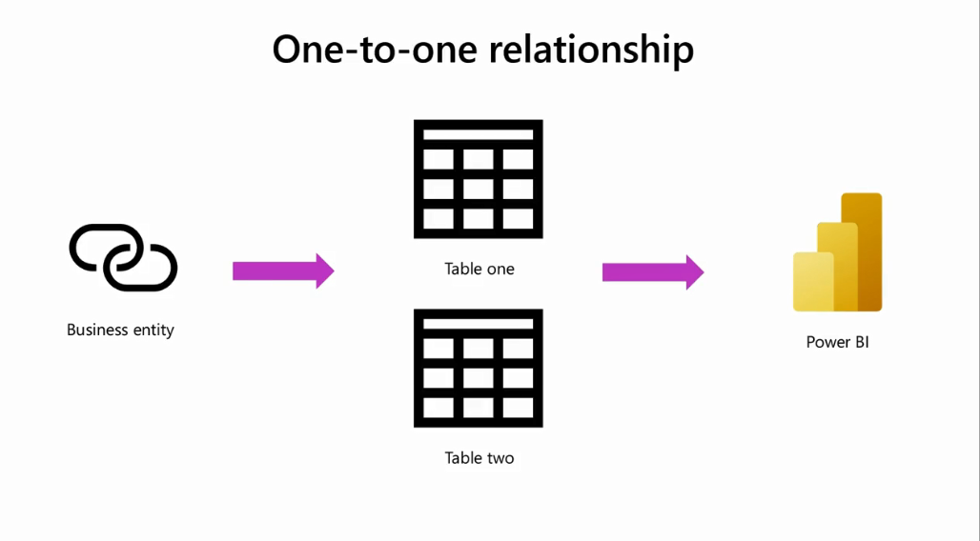

Slide 36
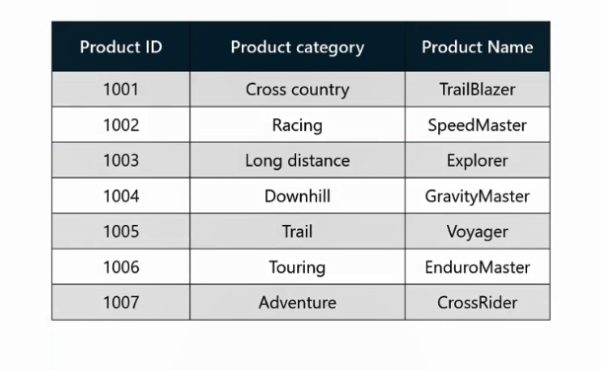
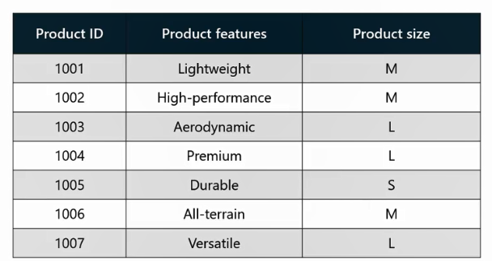
PK
PK

Slide 37
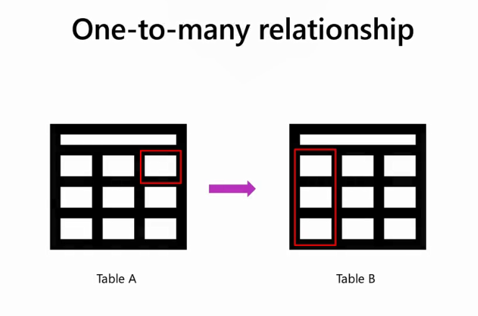

Slide 38
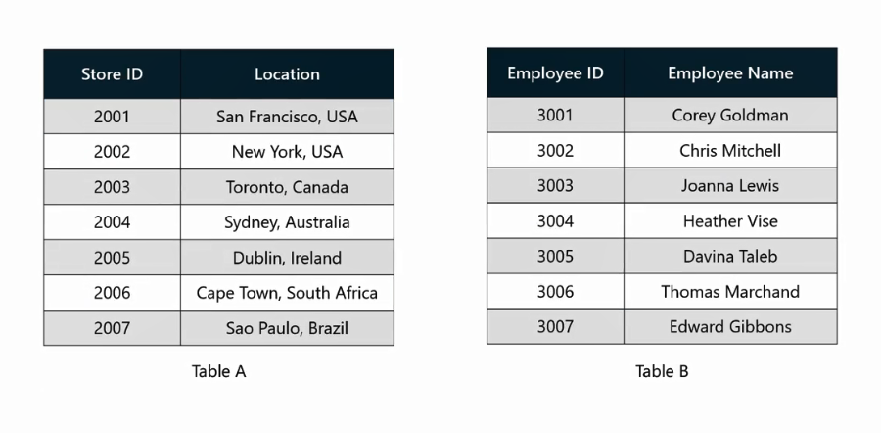

Slide 39
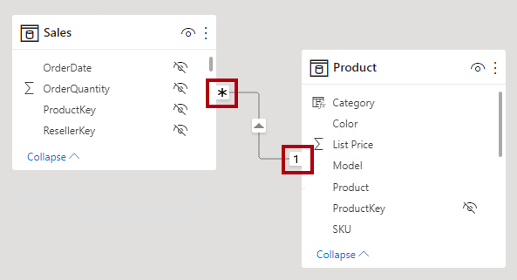

Slide 40
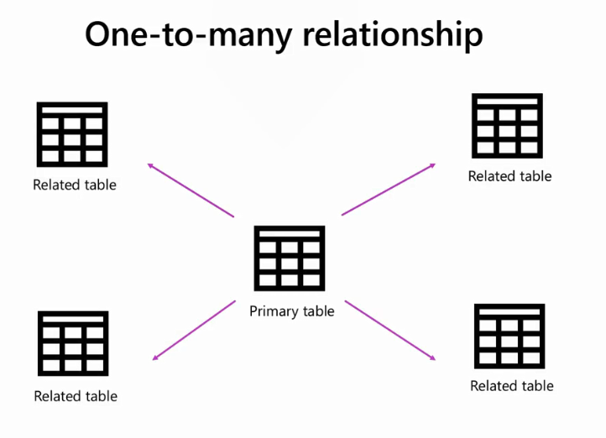

Slide 41
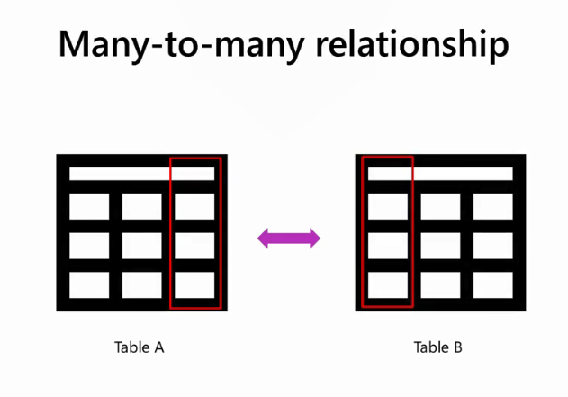

Slide 42
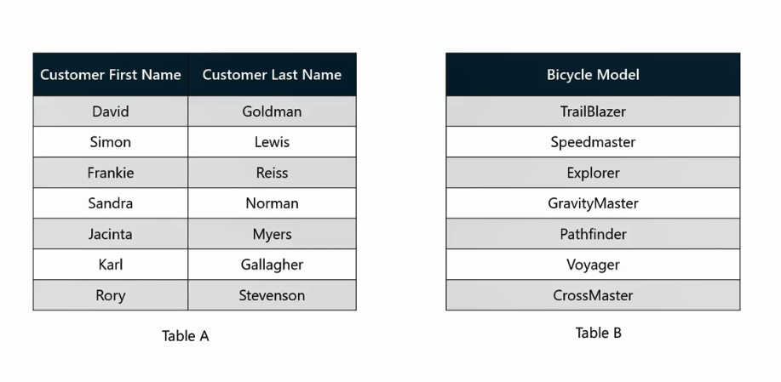

Slide 43


Slide 44

For example, geographical sales of products can be captured as a continent, country, state, city, and all the way down to individual stores.

Slide 45

An example of this is monthly sales of a product category. The sales data is summarized at the category level, but only on a monthly basis

Slide 46
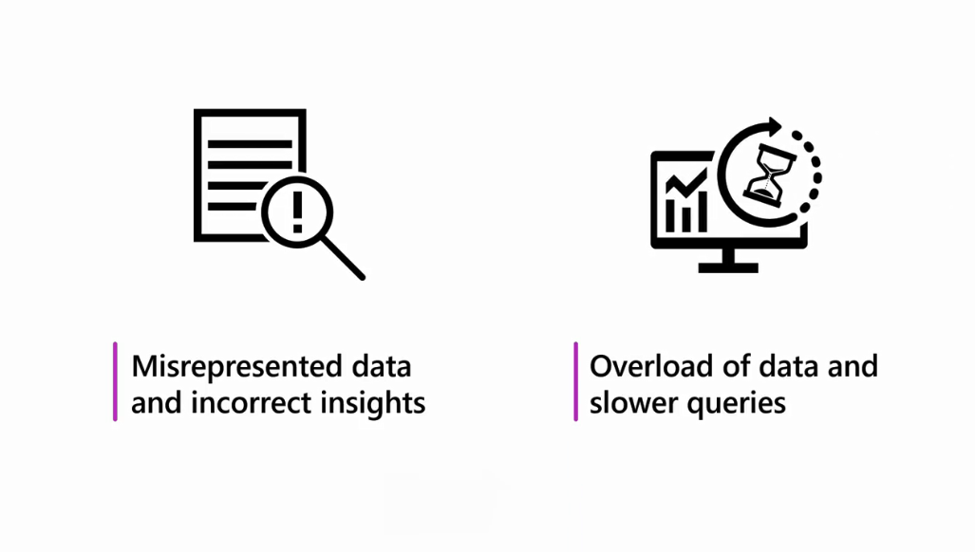
Be careful when judging the required level of granularity

Slide 47
Question
You are working on two tables where each record in a column of Table A corresponds to multiple records in a column of Table B, but not vice versa. What kind of relationship, or cardinality, is this an example of?
A one-to-one relationship.
A many-to-many relationship.
A one-to-many relationship.

Slide 48
ANSWER
You are working on two tables where each record in a column of Table A corresponds to multiple records in a column of Table B, but not vice versa. What kind of relationship, or cardinality, is this an example of?
A one-to-one relationship.
A many-to-many relationship.
A one-to-many relationship.

Slide 49
4
Model Relationship

Slide 50
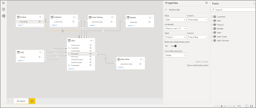
Creating relationships in Power BI
Autodetect relationships

Slide 51
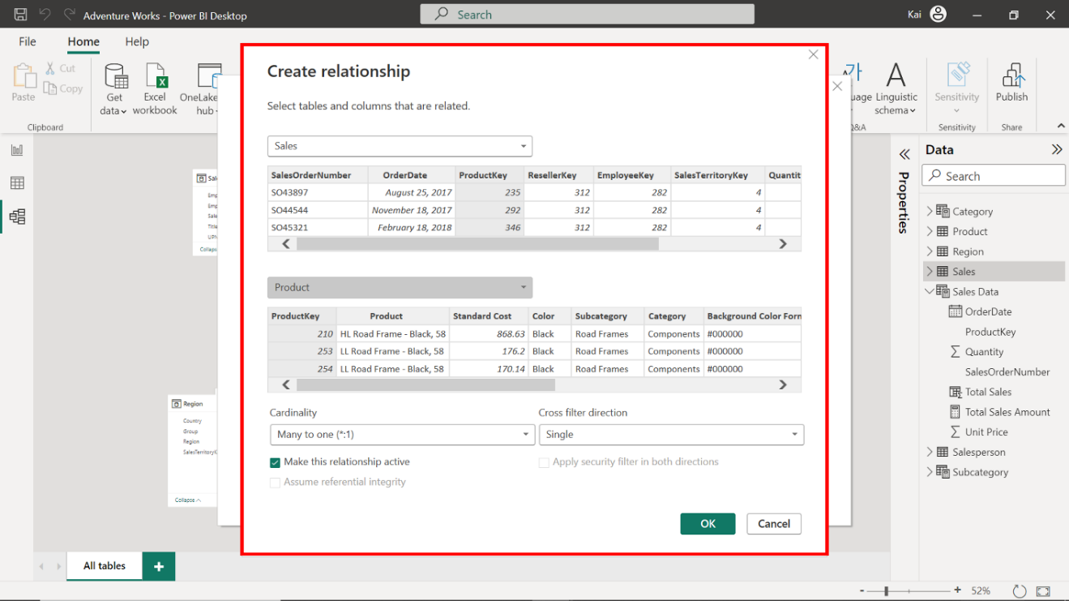
Creating relationships in Power BI
Manually create relationships
Access the Home tab, then select Manage Relationships

Slide 52
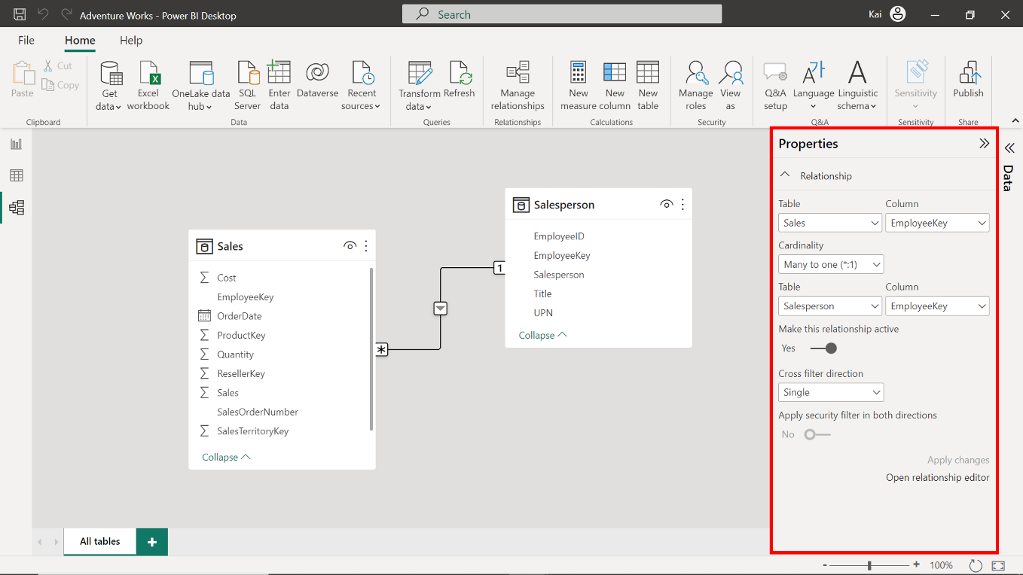
Editing relationships in Power BI

Slide 53
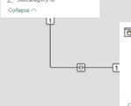
Model relationships
One of the most common relationships you’ll work with in your data models is a one-to-one relationship.
In a one-to-one relationship, each row in a table corresponds to no more than one row in another table.
This relationship only supports the Both crossfilter direction.
This means that when a filter is applied to one table, the filtering propagates to the other table.
One-to-one Relationship

Slide 54
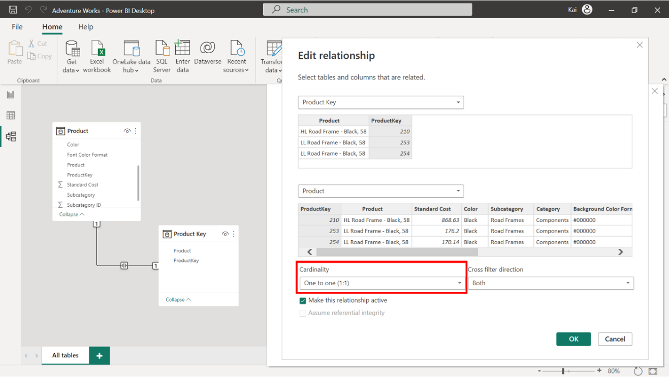
Model relationships
One-to-one Relationship

Slide 55
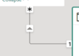
Model relationships
A one-to-many relationship exists where each value in the column of one table (Table A) can be associated with multiple values in the column of another table (Table B).
This is the most common cardinality type and the default relationship in Power BI.
In most data models, a one-to-many relationship describes the directionality between the Fact and the dimension table.
One-to-many relationship

Slide 56
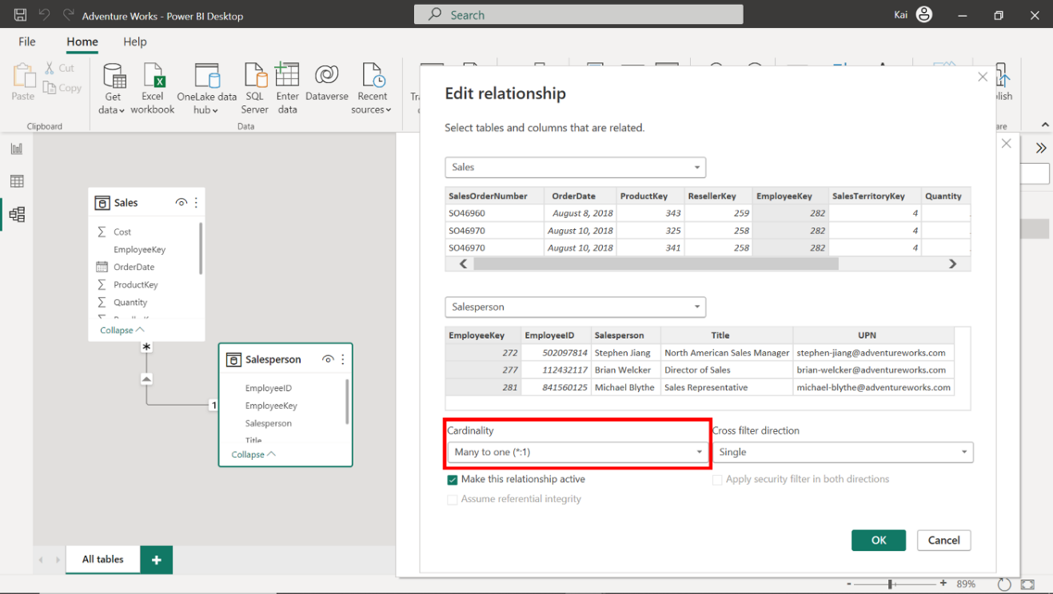
Model relationships
One-to-many relationship

Slide 57
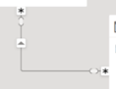
Model relationships
A many-to-many relationship exists when multiple values in the column of one table can be associated with multiple values in the column of a related table. This relationship does not require unique values for either table.
The disadvantage of a many-to-many relationship is that it introduces ambiguity in data analysis. So, it’s only recommended to use it in certain specific scenarios.
Typically, this relationship relates to two Fact tables or two dimension tables.
Many-to-many relationship

Slide 58
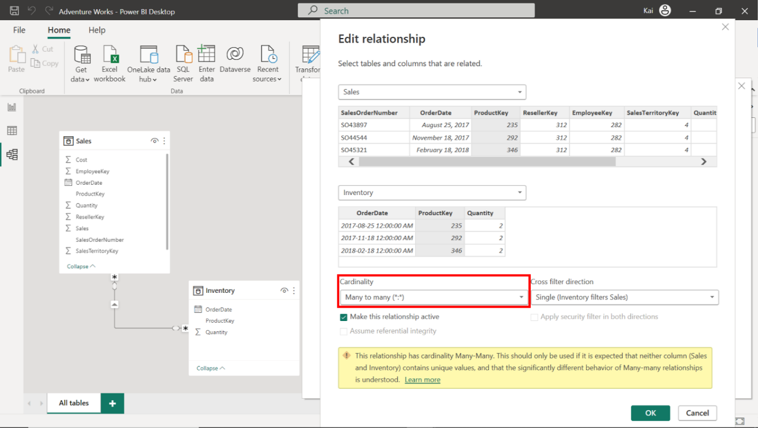
Model relationships
Many-to-many relationship

Slide 59
5
Cross-Filtering Direction

Slide 60


Slide 61

Your company needs to calculate which members of its sales team have sold the most product types and should be awarded a bonus.

Slide 62
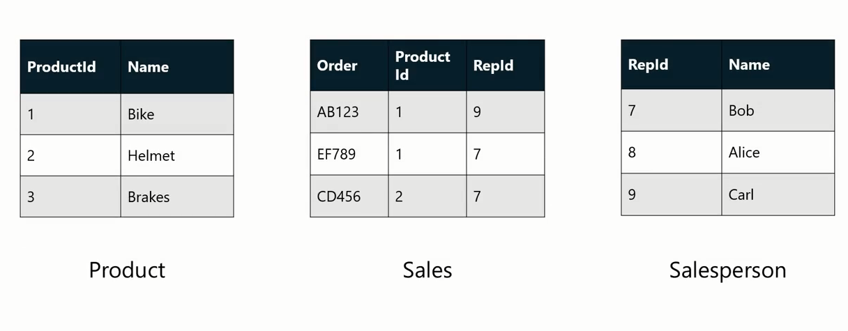
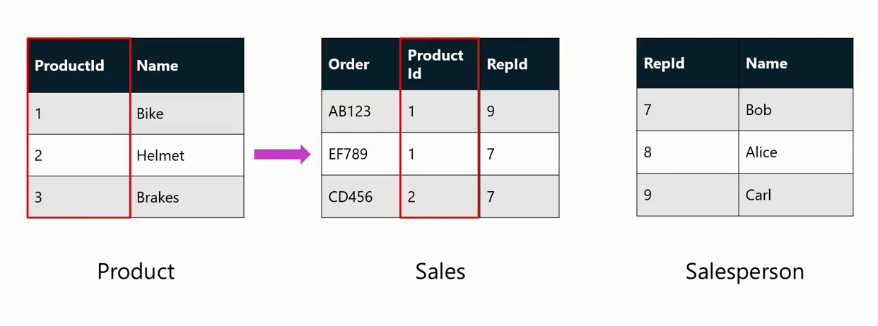
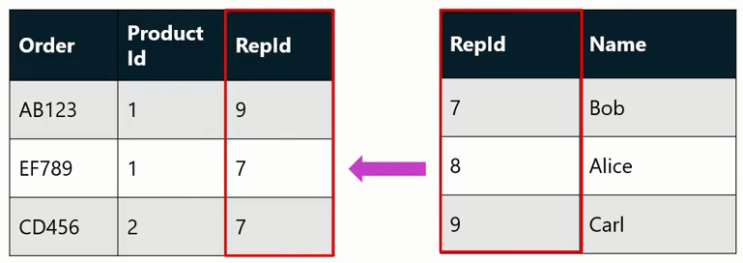

1-
1-

Slide 63


Slide 64

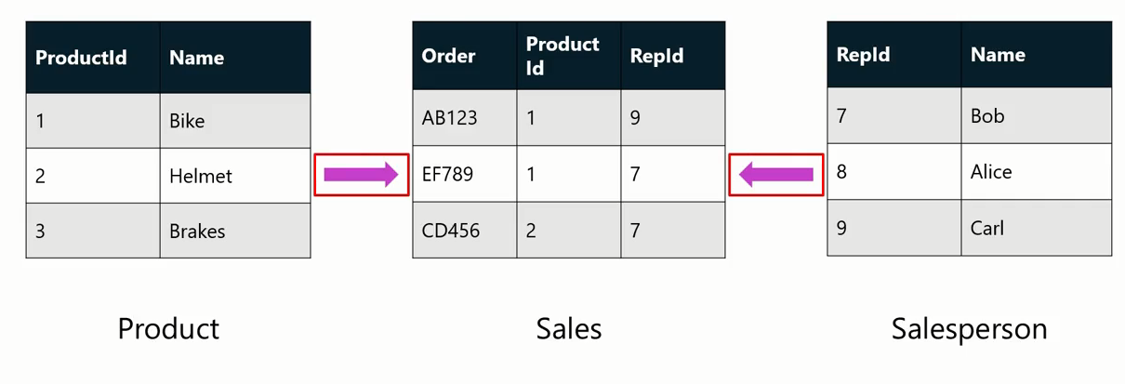

Slide 65
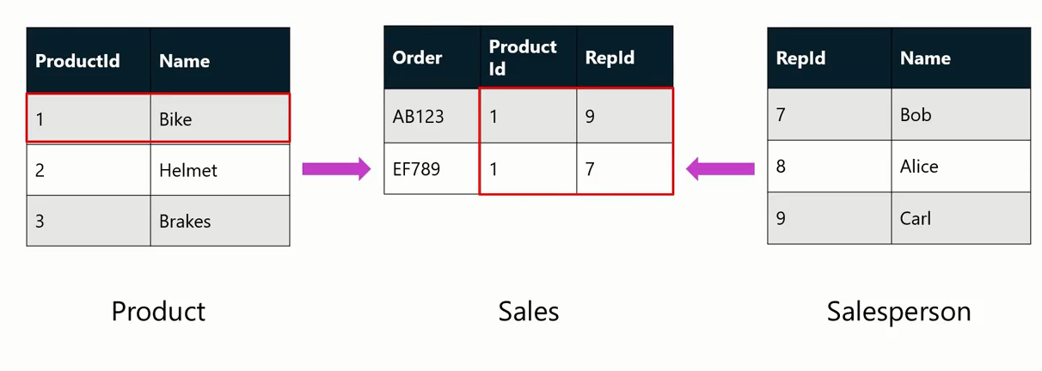

Slide 66


Slide 67

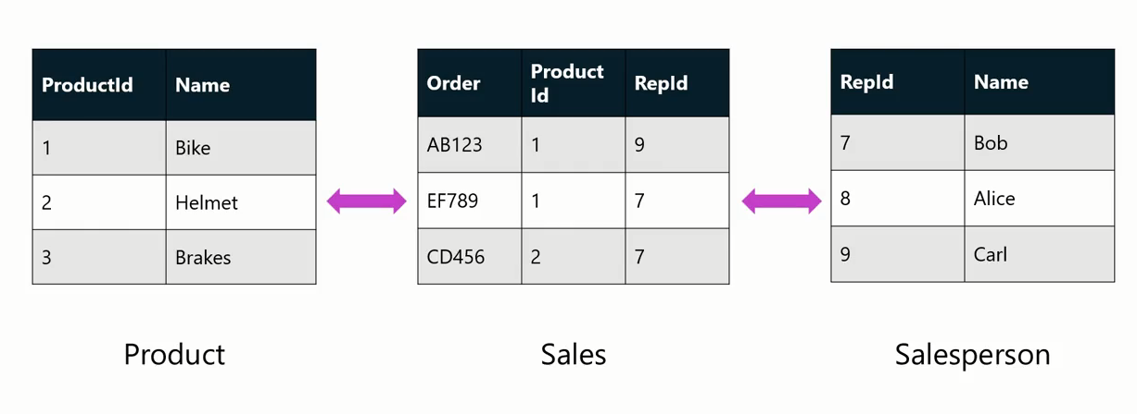
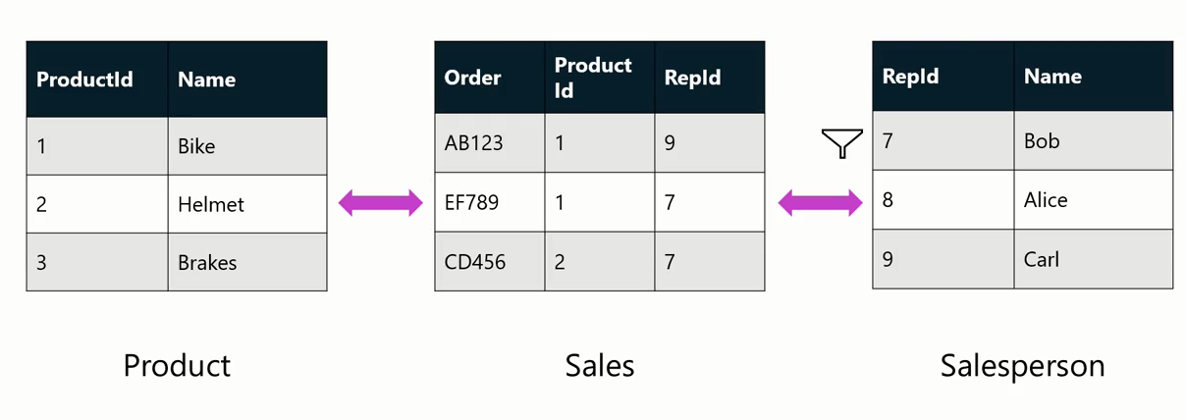
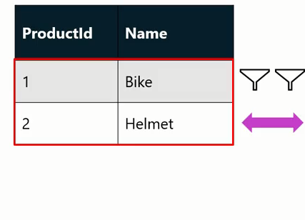

Slide 68


Slide 69


Slide 70
Question
Cross-filter direction refers to the direction in which filtering occurs between two tables in a data model.
True
False

Slide 71
ANSWER
Cross-filter direction refers to the direction in which filtering occurs between two tables in a data model.
True
False

Slide 72


Slide 73

Question 1
In the context of Power BI, which of the following descriptions best outlines the main purpose of a Fact table?
A Fact table is primarily used for storing detailed, transactional business data.
A Fact table is primarily used for storing descriptive attributes of business dimensions.
A Fact table is primarily used for storing measured, quantitative data about a business process.

Slide 74
ANSWER 1
In the context of Power BI, which of the following descriptions best outlines the main purpose of a Fact table?
A Fact table is primarily used for storing detailed, transactional business data.
A Fact table is primarily used for storing descriptive attributes of business dimensions.
A Fact table is primarily used for storing measured, quantitative data about a business process.

Slide 75
Question 2
Which of the following statements are true regarding cardinality and cross-filter direction in Power BI? Select all that apply:
Cardinality and cross-filter direction are two key elements of model relationships in Power BI.
Setting a cross-filter direction to Both allows filters to be applied from either direction in a relationship.
Cardinality defines the number of unique values in one column compared to another.

Slide 76
ANSWER 2
Which of the following statements are true regarding cardinality and cross-filter direction in Power BI? Select all that apply:
Cardinality and cross-filter direction are two key elements of model relationships in Power BI.
Setting a cross-filter direction to Both allows filters to be applied from either direction in a relationship.
Cardinality defines the number of unique values in one column compared to another.
A
B

Slide 77
Question 3
True or False: In Power BI, you can create a many-to-many relationship between tables.
True
False

Slide 78
ANSWER 3
True or False: In Power BI, you can create a many-to-many relationship between tables.
True
False

Slide 79
Question 4
In data analysis, __________ refers to the level of detail or summarization of your data.
Data granularity
Data cardinality
Cross-filter direction

Slide 80
ANSWER 4
In data analysis, __________ refers to the level of detail or summarization of your data.
Data granularity
Data cardinality
Cross-filter direction

Slide 81
Question 5
What is the role of dimension tables in Power BI?
They store measured, quantitative data about a business process.
They store the descriptive attributes of a business process.
They store transactional data related to a business process

Slide 82
ANSWER 5
What is the role of dimension tables in Power BI?
They store measured, quantitative data about a business process.
They store the descriptive attributes of a business process.
They store transactional data related to a business process

Slide 83


